Slide 1



Slide 2
COMPREHENSIVE DIGITAL MARKETING PROJECT ON
AMUL BRAND

Slide 3
.
Project submitted by
.
Team leader : Korupala Mamatha
Team member : Sontyana Jaswini
Team member : Bandaru Lavanya
Team member : Vabbalareddi Chandrasekhar

Slide 4
CERTIFICATE
This is to certify that KORUPALA MAMATHA Reg. No. 720120105074 has completed her internship project in APSCHE(SmartBridge Long-Term Virtual internship program) on “DIGITAL MARKETING PROJECT” under my supervision as a part partial fulfillment of the requirement for the Degree in the stream of B.sc Chemistry in the Department of A.M.A.L College, Anakapalli.

Slide 5
DECLARATION
I KORUPALA MAMATHA a student of A.M.A.L College Anakapalli Reg. No. 720120105074 of the Department of B.sc Chemistry here by declare that I have completed the manadatory internship project on “DIGITAL MARKETING”under the guidance of M.Venakatalakshmi Department of Physics in A.M.A.L College.

Slide 6
PRODUCT PROFILE:
Company Name : Gujarat co- operative milk marketing federation
Brand Name : Amul
Industry : Dairy
Founded : 1946
Location : Anand Gujarat

Slide 7
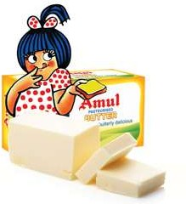
INTRODUCTION:
Amul, formed in 1946, is a dairy co-operative, based in Anand, Gujarat.
Establishment of Amul was marked as an epoch in white Revolution.
Largest food brand in India & world’s largest pouched milk brand.
It id a leader in ghee and butter with 85% market share.
It is available in affordable prices.

Slide 8

Brand Ambassador
.
Saif Ali Khan

Slide 9

Part 1: Brand Study, Competitor Analysis & Buyer’s/ Audience’s Persona
Research Brand Identity: Study the brand’s mission. Values, vision, and unique selling proportions (USPs) Mission Values: GCMMF endeavor to satisfy the taste and nutritional requirements of the customer of the world through excellence in the marketing by the committed team.
MISSION VALUES: We the motivated and dedicated workforce at Amul’s are committed to produce wholesome and safe foods with excellent quality to remain marketing development management system.
VISION: Amul’s vision to provide more satisfaction to the farmers, their customers, employees and their distributors.
USP: India’s most trusted and popular dairy product’s brand.

Slide 10
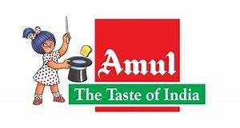
Part 1: Brand Study, Competitor Analysis & Buyer’s /Audience Persona
Analyze Brand Messaging: Amul’s low- cost pricing strategy, which was affordable by any income group, was one of the main reasons for its success. Amul’s- tagline ‘The taste of India’, banished the notion that bread and butter are a staple of only the British breakfast and brought nationalism into it.
The Amul model of dairy development is a three-tiered structure with the dairy cooperative societies at the village level federated under a milk union at the district level and a federation of member unions at the state level.
Examine the brand’s tagline: “THE TASTE OF INDIA”

Slide 11
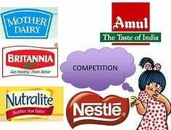
Part 1: Brand study, Competitor Analysis & Buyer’s Audience’s Persona
Competitor Analysis: Competitors in the AMUL industry and their USPs, and online communication
Its supply chain: Amul has large number of dairy suppliers which provides it tremendous strength and facilities Amul to produce high volumes by relying on Its supply chain.
It’s wide product portfolio: Amul has a really wide product line due to which it can run Amul shoppes and also maintain its product presence in marketing, especially at retail level.

Slide 12
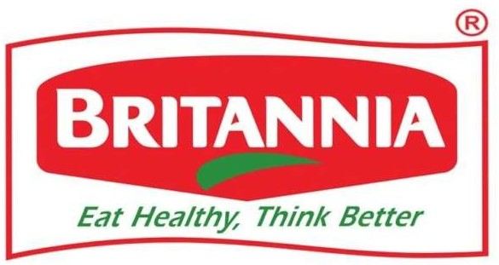
COMPETITOR 1:
USP: India’s very own bakery and dairy products brand that is trusted for its quality.
BRANDS LINK: https://www.Britannia.co.in

Slide 13

COMPETITOR 2:
USP: Nestle is one of the biggest food processing, health and wellness brand in the world.
BRAND LINK: https://www.nestle.in

Slide 14

COMPETITOR 3:
USP: India’s very own producer of milk products, beverage, foods etc. at affordable rates and of premium quality.
BRANDLINK: https://www.motherdairy.com

Slide 15
Part 1: Brand Study, Competitor Analysis & Buyer’s /Audience Persona
Buyer’s /Audience Persona: Amul has emerged as the No.1 dairy brand in India. Having an animal sales turnover of Rs18,150 crore. Its strategy of growth is driven by expansion, innovation and correct positioning of late, the brand has been target the younger demographic of the country. What is also noteworthy is how the brand has been reaching out to people in the remotest parts of the country and connecting with them through various media. Ankur Gaurav spoke to R S Sodhi. Managing Director, Gujarat co- operative milk marketing federation. Amul is brand for the entire family. Our target audience starts from consumers aged five to people in their 70’s. we cater to all income groups. A taxi driver in Mumbai is target for Amul as anybody from the upper class of society.

Slide 16

2: SEO & Key word Research
SEO Audit: The audit is made by Shivi Aggarwal,
https://www.bing.com/ck/a?!&&p=72df1d162f78c8b1JmltdHM9MTY4OTgxMTIwMCZpZ3VpZD0x YmZlNjIyNS1kZGMxLTY5MzAtMTIxNC03MTcxZDljMTZmMGImaW5zaWQ9NTIwNg&ptn=3&hsh=3 &fclid=1bfe6225-ddc1-6930-1214- 7171d9c16f0b&psq=amul+brand+audit+link&u=a1aHR0cHM6Ly93d3cuc2xpZGVzaGFyZS5uZXQvb WFkaHVzdWRhbnBhcnRhbmkvYW11bGJyYW5kLWF1ZGl0LTYyNTUwNzg&ntb=1

Slide 17
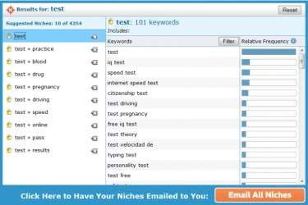
Keyword research:
KEYWORD DRIVE LINK: https://ads.google.com/intl/en_in/home/contact-us/schedule/?subid=in-en-ha-awa-sk-c-s00!o3~EAIaIQobChMIvvib7NCsgAMVd5lmAh3e5gADEAAYASAAEgKf7vD_BwE~137106993722~kwd-55513442713~16869585356~592430221804

Slide 18

On page optimization:
Keyword Research: Conduct through keyword research to identify relevant and high-traffic keywords related to Amul’s products. Use tools like Google keyword planner.
Title Tag and Meta Description: Advance the title labels and meta descriptions of each page with the objective watchwords to further develop navigates rates and web crawl rankings.
Quality Content: Make important and connecting with the content that tends to the necessities.
Web URL: https://amul.com

Slide 19

.
Part 3: Content Ideas and Marketing Strategies
Content idea Generating & Strategies:
.
17.Amul’s brand analysis
18.Competitor analysis
19.SEO audit of Amul’s brand
20.Content idea generation
21.Post creation
22. Social media Ad campaigns

Slide 20
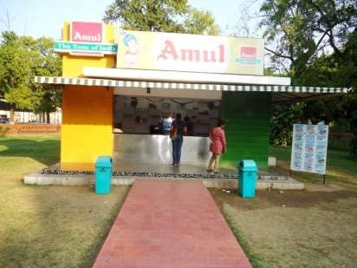
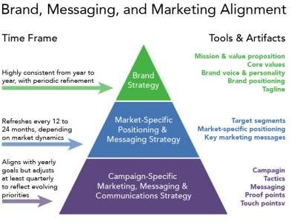
Part 3: Content Ideas and Marketing Strategies
Reflection of content ideas

Slide 21
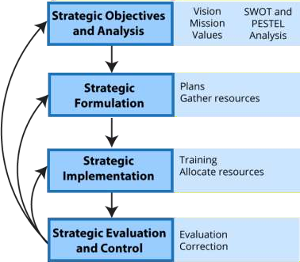
Strategies:
A look into Amul Marketing Strategies: The first time that most of us came across Amul was when the catchy the tune of ‘Amul Doodh Peetha Hai India’ rang from the television. Though many of us were really young at that time, ever since we whenever we encounter some variation or the other of the same tune, it never fails to evoke a melango of memories.
A plan of action to promote & sell a product or service
An organization strategy that combines all of its marketing goals into one comprehensive plan.
A good marketing strategy should be grown from marketing research and focus on the maximum profit potential and sustain the business.

Slide 22

Part 4: Content creation and Curation (Post creations, Designs/ Video Editing Ad Campaigns over Social Media and Email Ideation and Creation)
https://www.bing.com/ck/a?!&&p=62cf0de262b62e78JmltdHM9MTY4OTg5NzYwMCZpZ3 VpZD0xYmZlNjIyNS1kZGMxLTY5MzAtMTIxNC03MTcxZDljMTZmMGImaW5zaWQ9NTc1Nw &ptn=3&hsh=3&fclid=1bfe6225-ddc1-6930-1214- 7171d9c16f0b&u=a1L3ZpZGVvcy9zZWFyY2g_cT1hbXVsK2JyYW5kK2FkdmVydGlzZW1lbnQ rdmlkZW8mZG9jaWQ9NjAzNTM4MDY4NzEyNzI4NzA3Jm1pZD02Mjc1OTQ2NDhDRUZCOT cyNDUxMTYyNzU5NDY0OENFRkI5NzI0NTExJnZpZXc9ZGV0YWlsJkZPUk09VklSRQ&ntb=1

Slide 23


Part 4: Content creation and Curation (Post creations, Designs/ Video Editing Ad Campaigns over Social)
INSTAGRAM STORY
INSTAGRAM: https://www.instagram.com/amul_india/?hl=en

Slide 24
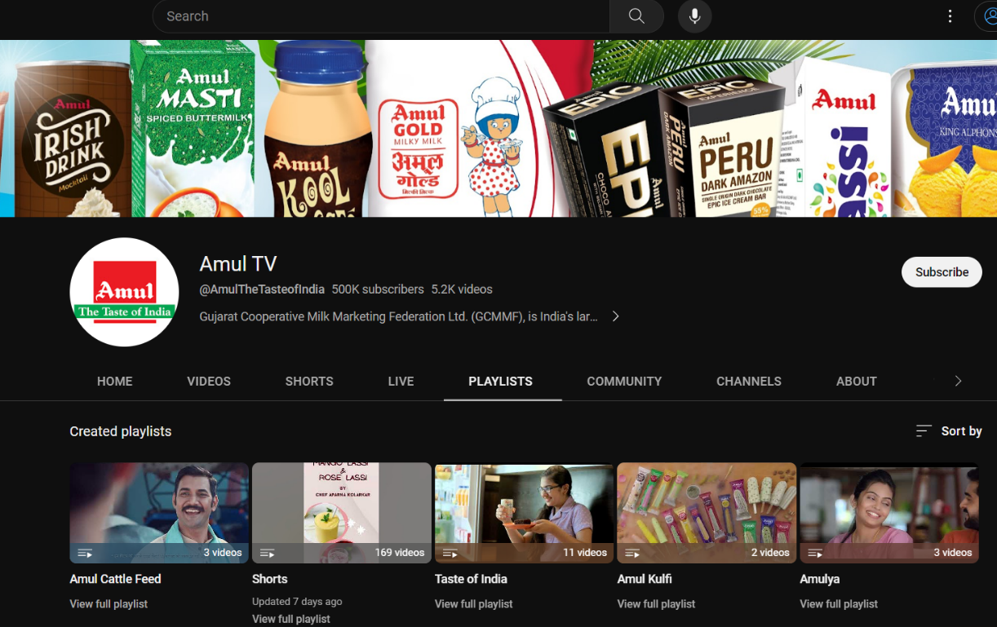
Part 4: Content creation and Curation (Post creations, Designs/ Video Editing Ad Campaigns over Social Media and Email Ideation and Creation)
YouTube Channel Link: https://m.youtube.com

Slide 25
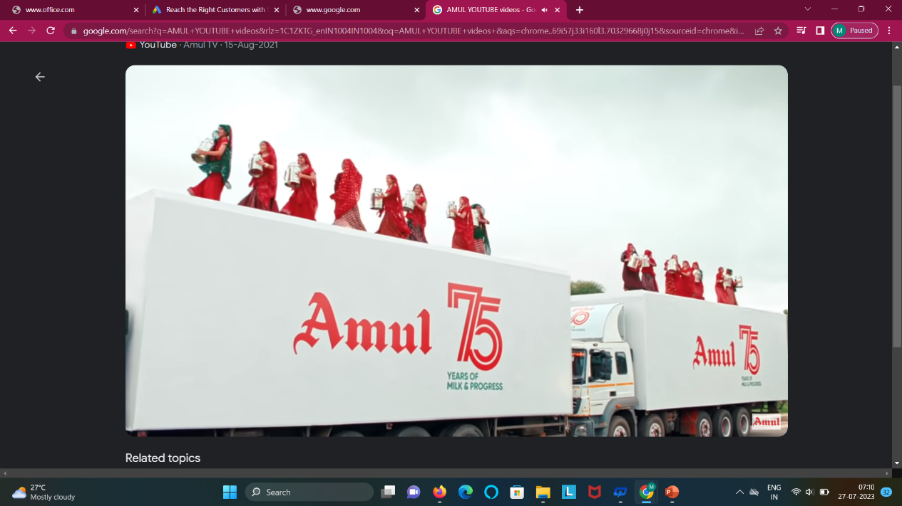
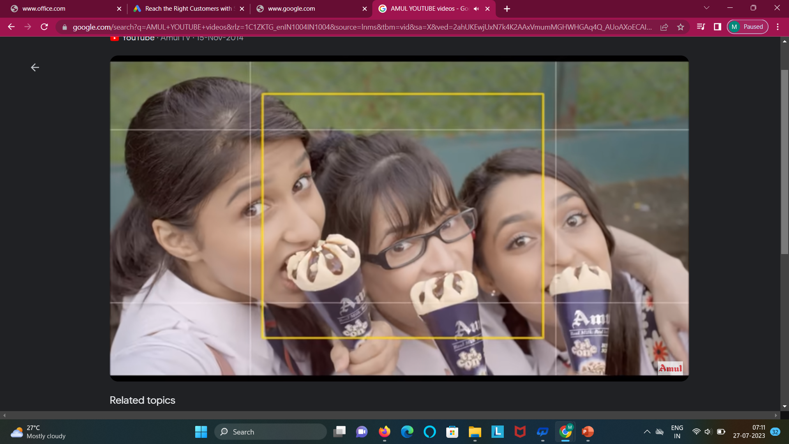
YOUTUBE ADVERTISING ADS:
YouTube: https://youtu.be/ciGHpicoyks
YouTube: https://youtu.be/jgAbJn8JKLk

Slide 26

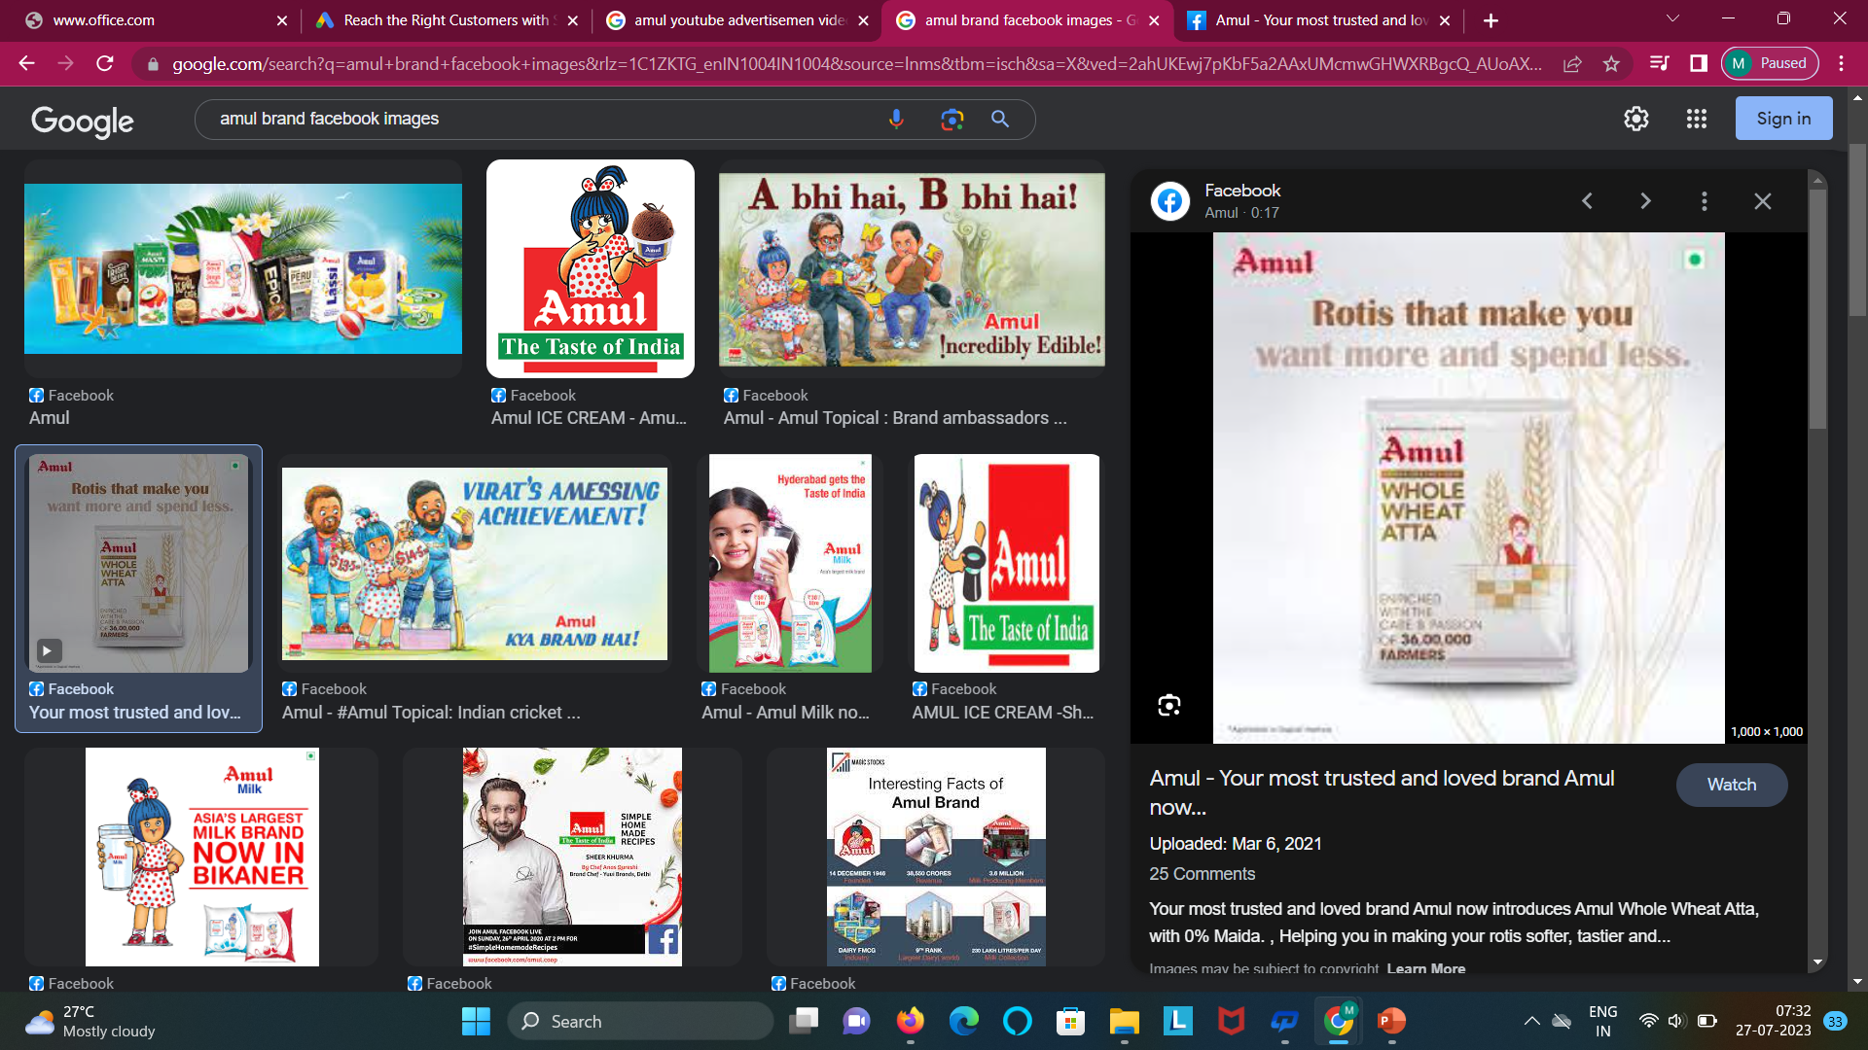
Facebook Ad campaigns:
Facebook: https://m.facebook.com/amul.coop

Slide 27
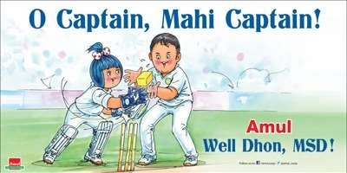
.
Part 4: Content creation and Curation (Post creations, Designs/ Video Editing Ad Campaigns over Social Media and Email Ideation and Creation)
.
Social Media Ad Campaigns
.
https://www.bing.com/aclk?ld=e88EWdx9MHYxihOAx36vWflzVUCUwXb1oMo_NxNRSr-6anovUUS0GeKzMFKVY4lDW- Sc8isihQi_mxb0jON9sIDPFwtoVXfyFsPtcn9eUKlgCr34SKNUZhOJcN3KlnxhkUDRN9Yq2Q- pd8QSH6SN8Xa5SOctPZt3auqLQySP0AyWl104rRI1Z2sYRhsT8VNrkWMhtrJw&u=aHR0cHMlM2ElMmYlMmZjbGlja3NlcnZlLmRhcnRzZWFyY2gubmV0JTJmbGluayUyZmNsaWNrJ TNmbGlkJTNkNDM3MDAwNzEwNzg3ODYwOTMlMjZkc19zX2t3Z2lkJTNkNTg3MDAwMDc4MTkyNDc2MDclMjYlMjZkc19lX2FkaWQlM2Q3NDQ5MjA3MDE2ODQ0OSUyNmRzX2 VfdGFyZ2V0X2lkJTNka3dkLTc0NDkyMTc5MTE1NzE4JTNhbG9jLTkwJTI2JTI2ZHNfZV9uZXR3b3JrJTNkbyUyNmRzX3VybF92JTNkMiUyNmRzX2Rlc3RfdXJsJTNkaHR0cHMlM2ElMm YlMmZhZHMuZ29vZ2xlLmNvbSUyZmludGwlMmZlbl9pbiUyZnN0YXJ0JTJmb3ZlcnZpZXctYWRvbiUyZiUzZnN1YmlkJTNkaW4tZW4tYWRvbi1hd2Etc2NoLWMtYmJiIW8zJTdlM2Yw MDk0ZGM3ODYzMWY1ODk1YTBmMDY2MzI4YjVmODMlN2VwNzEwNzg3ODYwOTMlN2UlMjYlMjYlMjYlMjYlMjZnY2xpZCUzZDNmMDA5NGRjNzg2MzFmNTg5NWEwZjA2NjMy OGI1ZjgzJTI2Z2Nsc3JjJTNkM3AuZHMlMjYlMjZtc2Nsa2lkJTNkM2YwMDk0ZGM3ODYzMWY1ODk1YTBmMDY2MzI4YjVmODM&rlid=3f0094dc78631f5895a0f066328b5f83&ntb= 1

Slide 28
.
Part 4: Content creation and Curation (Post creations, Designs/ Video Editing Ad Campaigns over Social Media and Email Ideation and Creation)
For every campaign clearly define: Amul needs no introduction. It is an Indian and very successful dairy products brand. I am sure you can find an Amul product in your home.
Advertising Goal:
Social media Marketing: Amul can create brand pages and profiles on popular social media platforms such as face book, Instagram, Twitter and Linked in. They can share enagaging content, including mouth watering images
Influencer Collaborations: Amul can collaborate with social media influencers or bloggers who have a significant following and influence in the food or snack niche. By partnering with relevant influencers, they can reach a wider audience and generate awareness through sponsored content.
Content Marketing: Developing a content marketing strategy can be beneficial for selling the products of Amul’s brand.
.
Notes:
Audience Target: Amul has broader target audience, from a toddler to aged people.
Ad Creation: The first ad, with the word ‘through bread’ along with Amul’s slogan ‘utterly Butterly Delicious’, first appeared in March 1966, with the Amul girl riding a horse.

Slide 29
Pay per click Advertising: we can create a post regarding the content of Amul’s brand product and we can good reach in it. From that we can pay for the each click of the post.
Email Marketing: Building an email subscriber list through their website or social media channels directly. They can send out newsletters, exclusive offers, new product launch and personalized recommendations to nature customer relationships and encourage repeat purchases.
Video Marketing: Creating engaging and informative snack related videos on platforms like YouTube or TikTok can help to reach higher percentage of audience They can also show recipes' and collaborate with people in a easy manner through social media based on digital marketing.
Audience Target: Amu l has broader target audience, from a toddler to aged people.
AMUL MARKETING MIX:
Product
Promotion
Price
Place
Ad Creation: The first ad, with the word ‘through bread’ along with Amul’s slogan ‘utterly Butterly Delicious’, first appeared in March 1966, with the Amul girl riding a horse.

Slide 30

Part 4: Content creation and Curation (Post creations, Designs/ Video Editing Ad Campaigns over Social Media and Email Ideation and Creation)
Ad Campaign for Email Marketing:
Once the personalities in the images are resolved, one gets an idea about the event being referred to. Then, the wit in the text can be understood in a better way.
Email Services: customercare@amul.coop

Slide 31
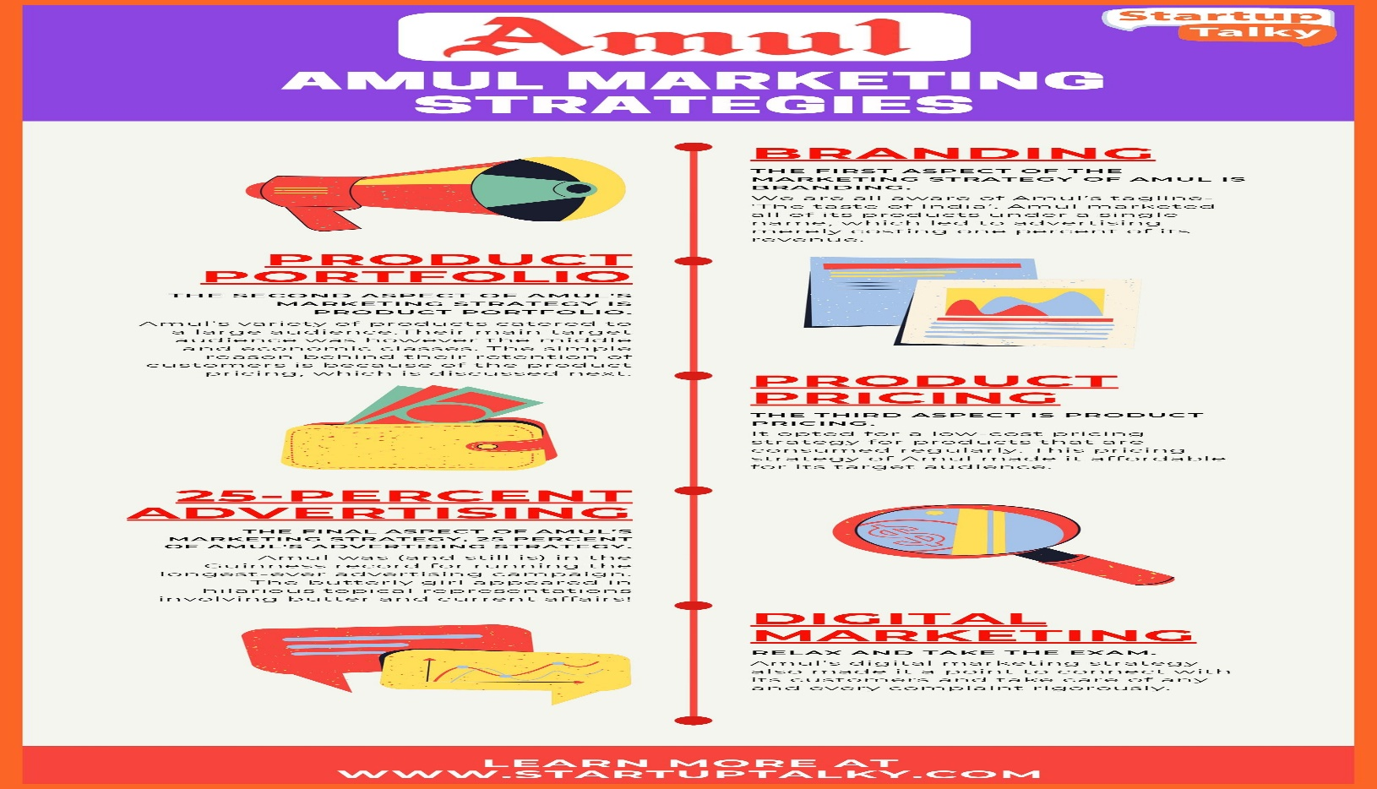
Email Ad Campaigns – Amul’s Brand

Slide 32
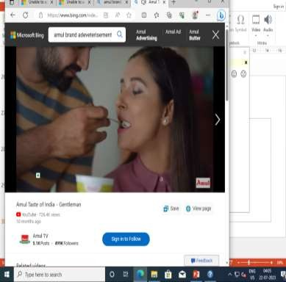
Part 4: Content creation and Curation (Post creations, Designs/ Video Editing Ad Campaigns over Social Media and Email Ideation and Creation)
https://www.bing.com/ck/a?!&&p=22d258960b093d50JmltdHM9MTY4OTk4NDAwMCZpZ3VpZD0xYmZlNjIyNS1k ZGMxLTY5MzAtMTIxNC03MTcxZDljMTZmMGImaW5zaWQ9NTc3NQ&ptn=3&hsh=3&fclid=1bfe6225-ddc1-6930- 1214-
7171d9c16f0b&u=a1L3ZpZGVvcy9zZWFyY2g_cT1hbXVsK2JyYW5kK3ZpZGVvK2FkdmVydGlzZW1lbnQmZG9jaWQ9 NjAzNTM4MDY4NzEyNzI4NzA3Jm1pZD02Mjc1OTQ2NDhDRUZCOTcyNDUxMTYyNzU5NDY0OENFRkI5NzI0NTExJn
ZpZXc9ZGV0YWlsJkZPUk09VklSRQ&ntb=1

Slide 33
CONCLUSION:
Amul has risen from Indian soil and it remains Indian in every sense. There is ample scope in the low priced segment as also in other categories. There are a significant number of retails who are currently stocking more than two brands.
Amul has the opportunity to capture the more evolved young adults and children who are open to new products provided they must their expectations.
Amul has risen from Indian soil and it remains Indian in every sense. Amul has the opportunity to capture.
Though Amul hoardings are a
huge success, it can penetrate even better in the rural by advertising through the media.

Slide 34
.
THANK YOU

